Slide 1
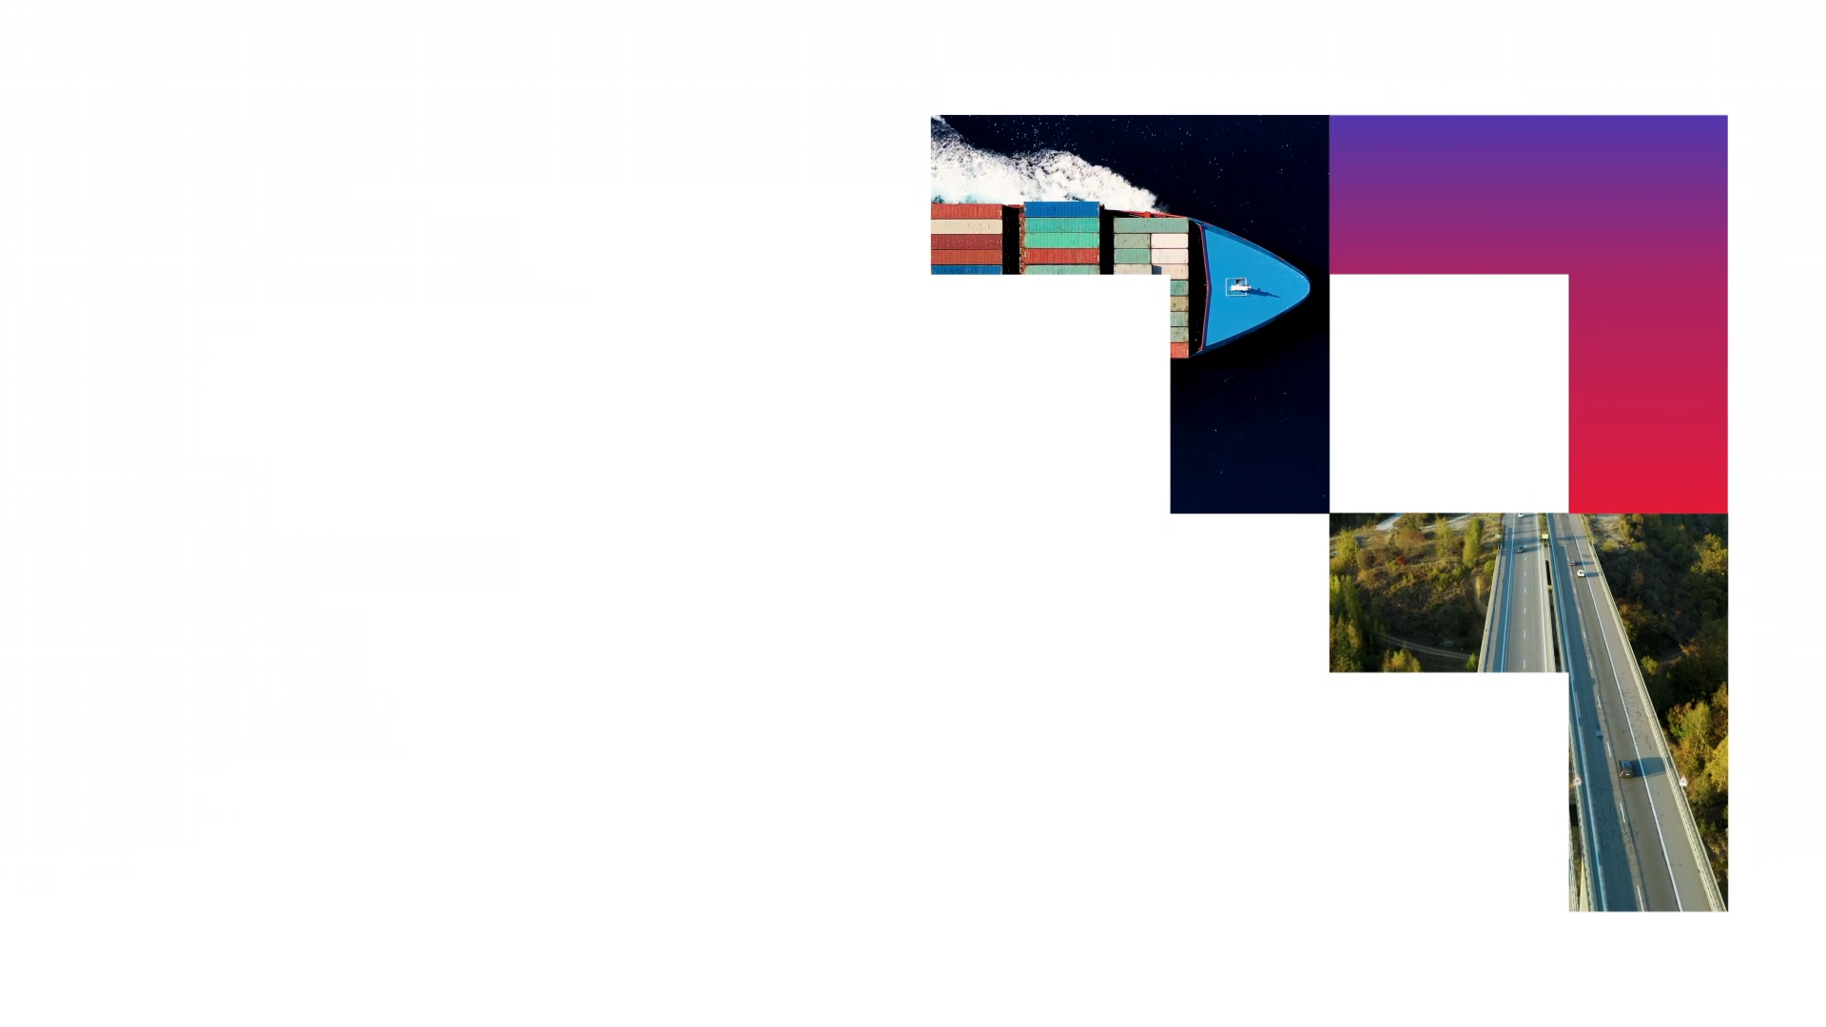

The world of Containers
Jeroen Claassens
Gerard Mulder
Brendan van Walstijn
Classification: Internal

Slide 2
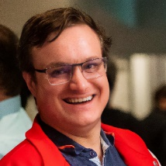

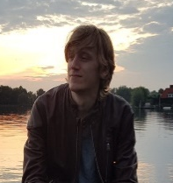
Who are we
Jeroen Claassens | Consultant Randstand & North Netherlands | Infrastructure | CGI
George Hintzenweg 89 | Postbus 8566 | 3009 AN Rotterdam | The Netherlands
M: +31 (0)6 5112 7382
j.claassens@cgi.com
Gerard Mulder | Senior Consultant Randstand & North Netherlands | Infrastructure | CGI
George Hintzenweg 89 | Postbus 8566 | 3009 AN Rotterdam | The Netherlands
M: +31 (0)6 1353 8868
g.mulder@cgi.com
Brendan van Walstijn | Experienced Software engineer
Randstand & Central Netherlands | Transport | CGI
George Hintzenweg 89 | Postbus 8566 | 3086AX Rotterdam | The Netherlands
M: +31 (0)6 1836 6194
Brendan.van.walstijn@cgi.com
Notes:
Allemaal om de beurt.

Slide 3


Who am I?
Jeroen Claassens
Java / TypeScript / CI/CD
Software Engineering
5 years @ CGI
Also active of the CGI Emerging Technologies practise for AI
Be sure to sign up for the next dev@cgi event, we’re going to make it awesome 😉
Notes:
Jeroen

Slide 4
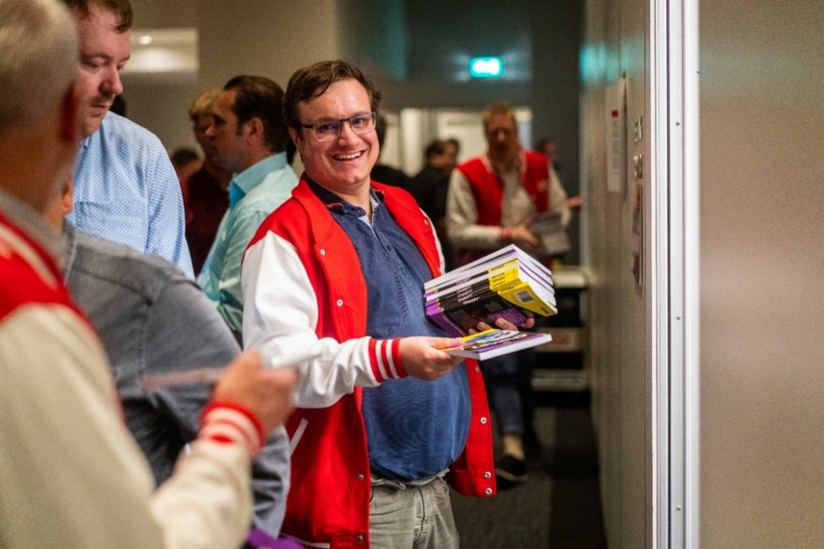
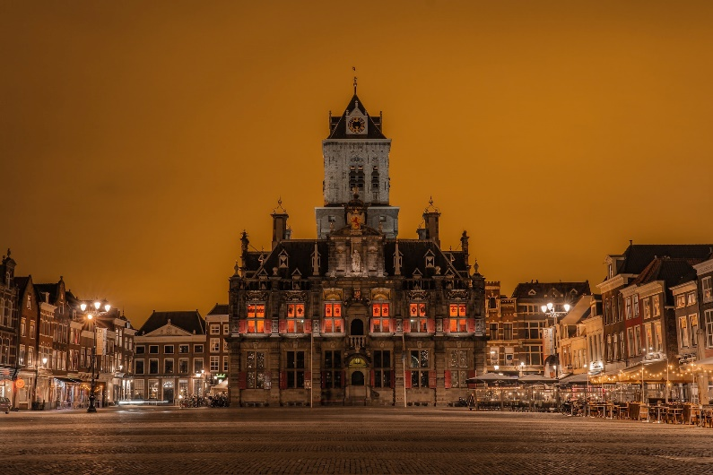
Who am I?
I’m love all fantasy (talk to me about Brandon Sanderson, Dungeons & Dragons, and more)
My free time is primarily spent with open-source development and (table-top) gaming.
I love learning about and working with all tech.
I live in Delft
Notes:
J: I live in the city of Delft. In my spare time I’m a huge lover of all kinds of fantasy. My free time I primarily spent workin on various open source projects that I maintain and I also game a lot. In general I am also a big fan of all things tech.

Slide 5

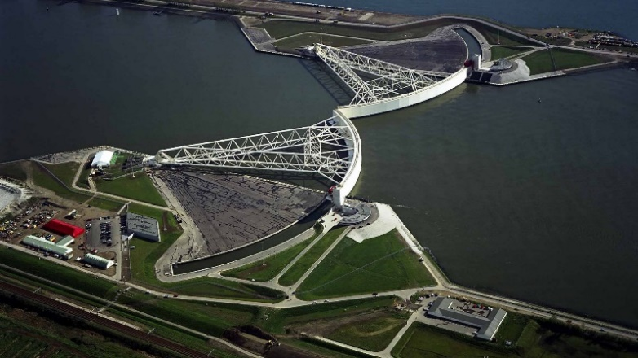
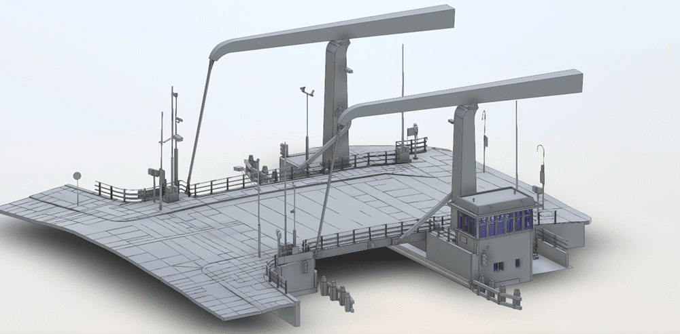
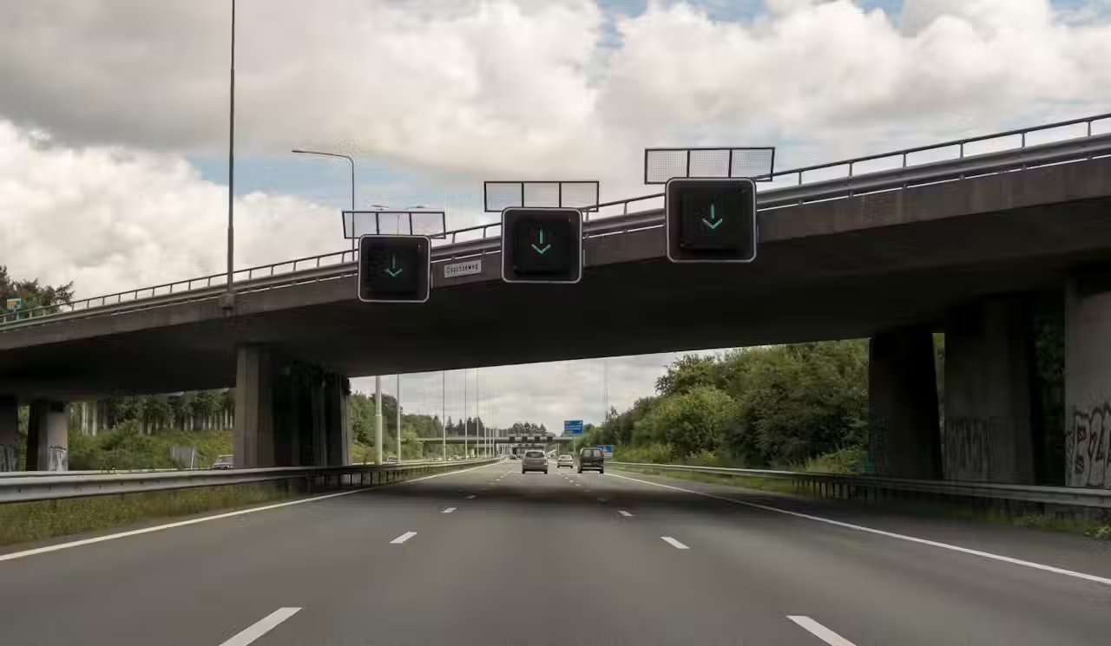
Who am I?
Gerard Mulder
Java / C++ / Python / CI/CD / Cloud Native / Cloud Foundry / Kubernetes
Software Engineering & Architecture
18 years @ CGI … and still going strong
Started with “Masterclass Java”, just like you!
Notes:
Gerard

Slide 6
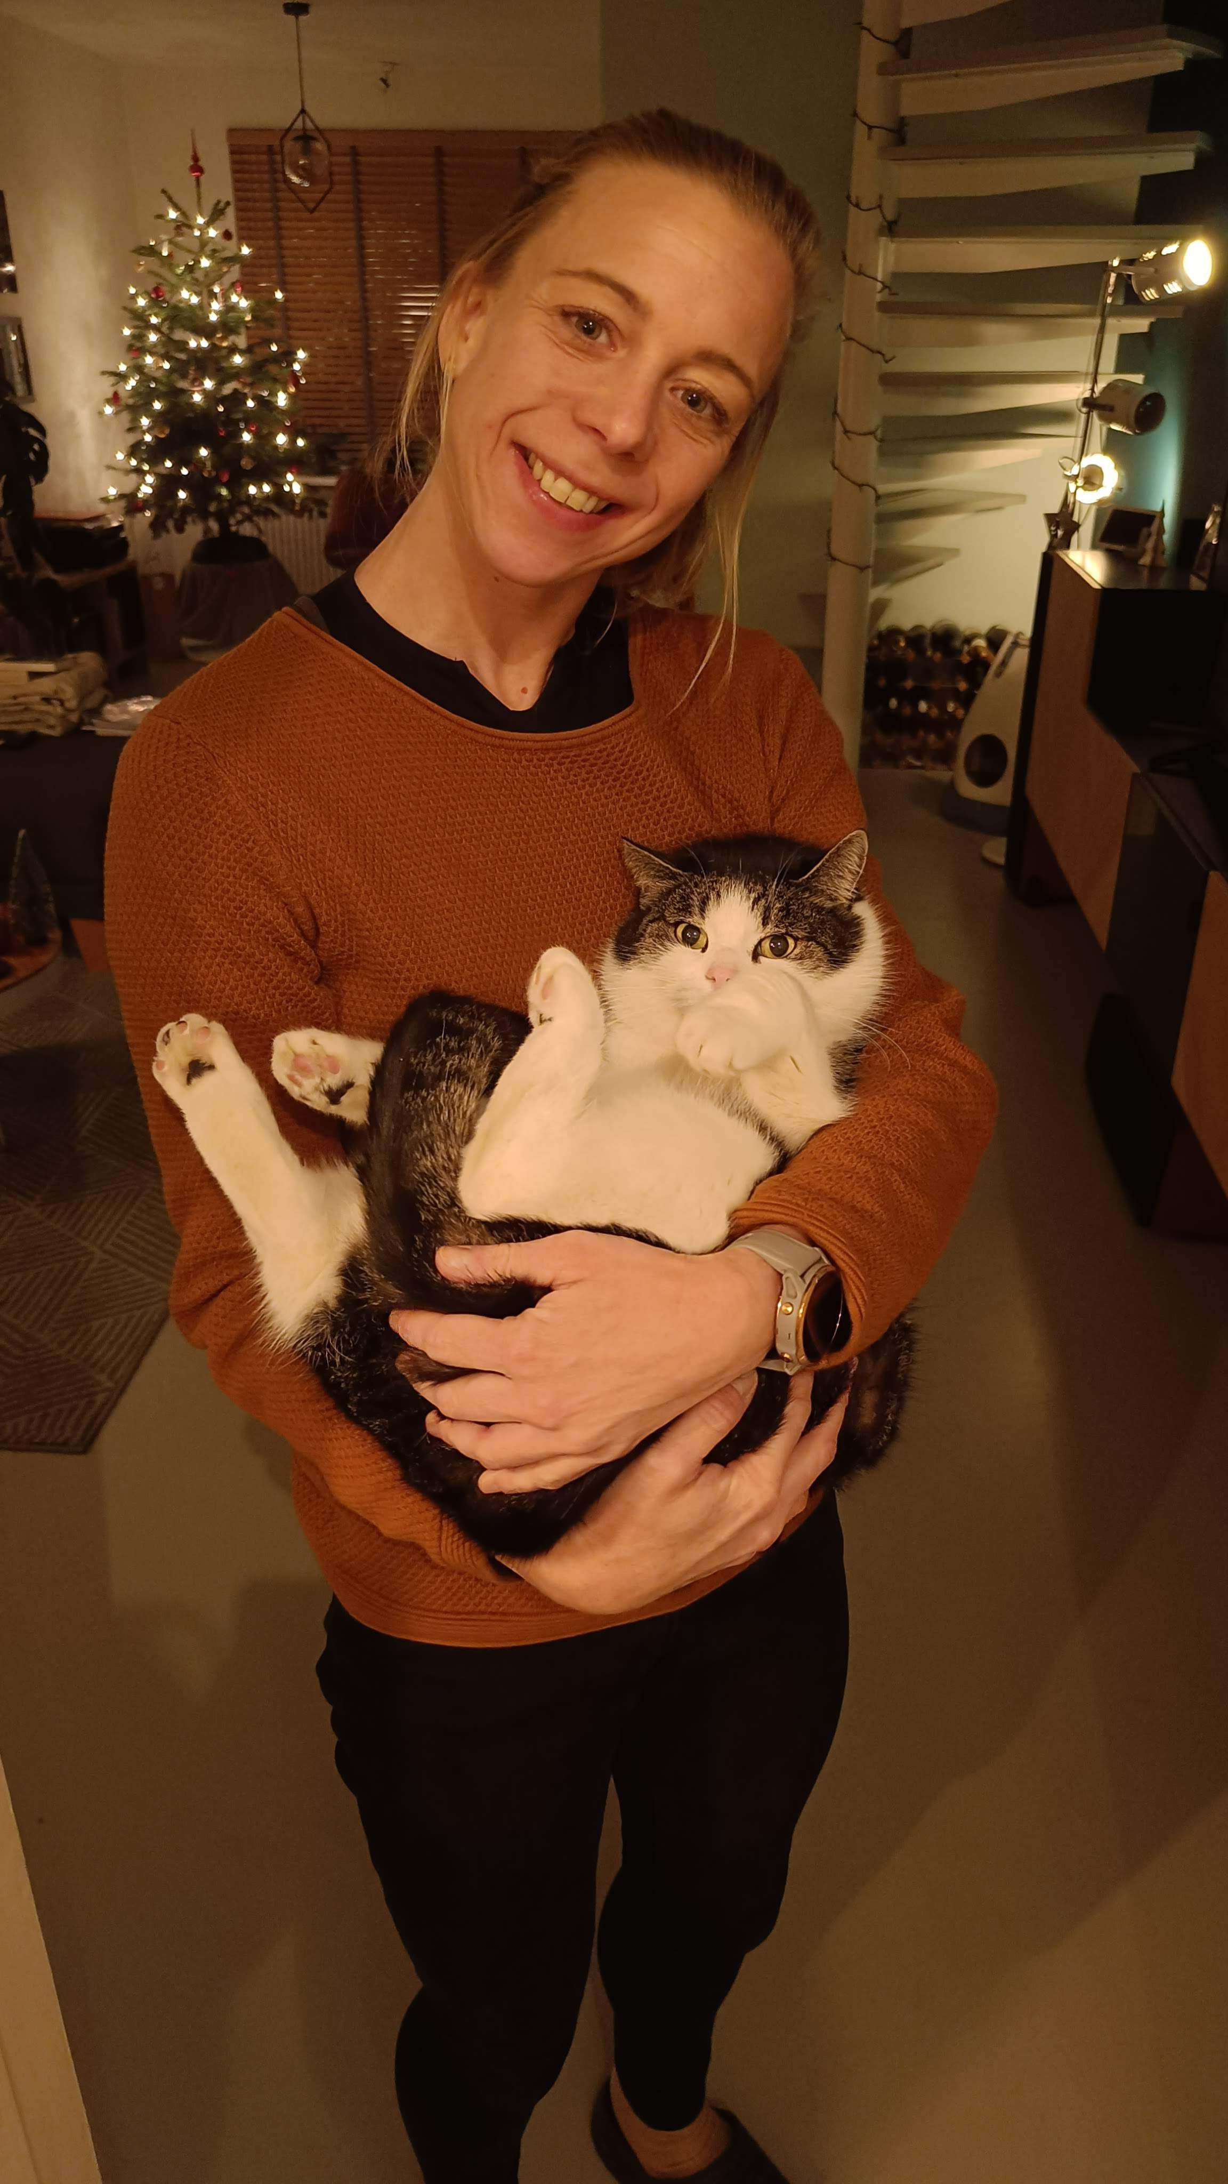
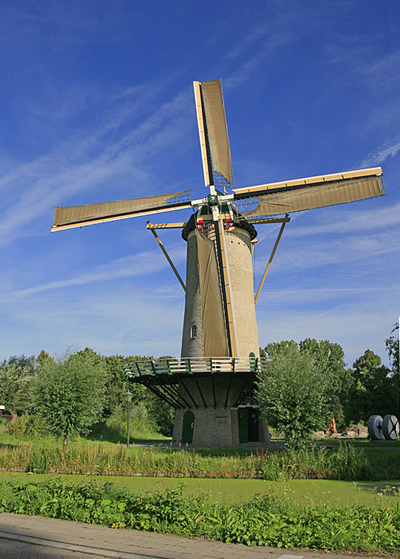
Who am I?
I live in Rotterdam with my girlfriend Pauline and our cat Willem
Too many hobbies: Cycling (Road & Gravel), CrossFit, Field Hockey, Surfing, Gaming, Volunteer Miller, Volunteer KiKa
Favourite bands: Muse, Placebo, Biffy Clyro
Ideal holiday: Surf or Bikepack trip
Other interests: NFL, VHS (Tape), Movies, Science-Fiction books, Retro Computers, Space, Board games
Notes:
Gerard

Slide 7




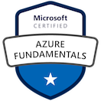


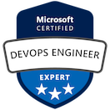
Who am I?
Brendan van Walstijn (Experienced Software Engineer)
Started at CGI in March 2021
Started with the Graduate Class and the .NET track
Loodswezen (6 months)
.NET Developer
Primarily worked on a decision tree for Beurtrollen
Athlon (11 months)
DevOps Engineer
SQR -> SQL rewrite
Worked on test automation using PowerShell
NextLogic (Current)
Azure Cloud Engineer
Primarily Administrative tasks
Transavia (Current)
Azure DevOps and Cloud Engineer.
Development of Partner Admin Portal in C# and Blazor/Radzen
Primary focus on Azure Infrastructure using bicep/ARM and configuration
Notes:
Brendan

Slide 8
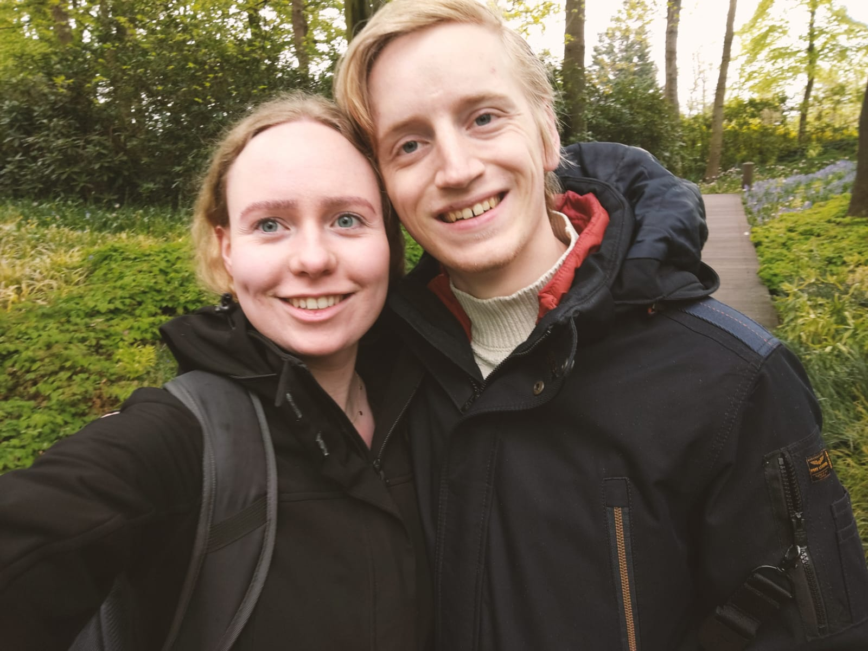
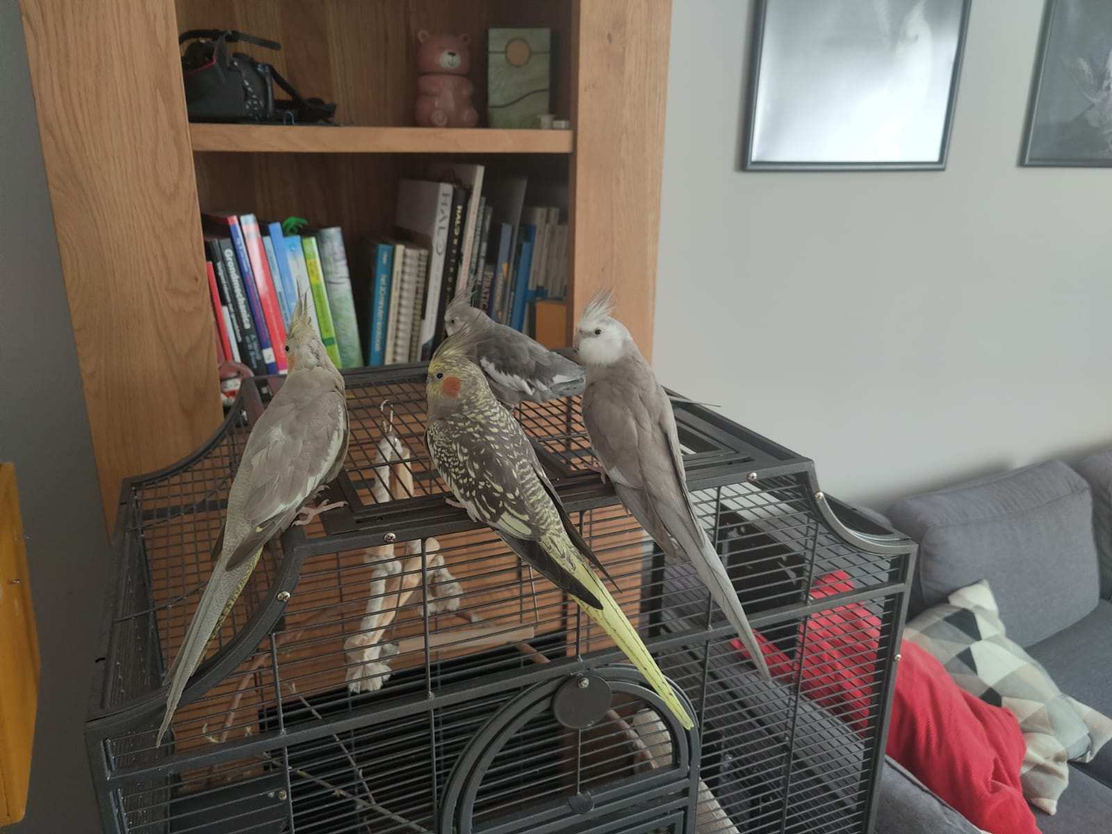
Who am I?
I Live in Noorden with my girlfriend Rosalie and a number of birds.
If you know where Noorden is, I’ll buy you lunch. (googling not allowed)
I Play Piano and (bass)guitar in a punk rock band. (Blink-182, Sum 41, Green day, Rage Against the Machine, and some own stuff)
Guitar of choice: Epiphone Les Paul Modern (sparkling burgundy)
Favourite song to play: Top gun Anthem by Steve Stevens.
Notes:
Brendan

Slide 9

Our vision on this course
Notes:
Self explanatory

Slide 10
What does an application need in order to be able to run?
Notes:
Bredan/Gerard/Jeroen?

Slide 11
What does an application need in order to be able to run?
Runtime (e.g. JVM or .NET runtime)
Source Code
Compiler
Runtime
“something” that runs your compiled app
…
…
…
…
Notes:
Platform om applicaties te runnen, bouwen en te shippen. Dit platform voorziet dus van alle benodigdheden om een applicatie te kunnen runnen.

Slide 12
How do we provide a runtime for an application?
Notes:
Bredan/Gerard/Jeroen?

Slide 13
How do we provide a runtime for an application?
Pc / laptop / server / (cloud?)
Virtual Machine
Source Code
Compiler
Runtime
OS
“something” with an OS and resources
CPU
HDD
Mem
Notes:
Typische productie/enterprise omgeving: VM’s. Wie weet wat een VM is?

Slide 14
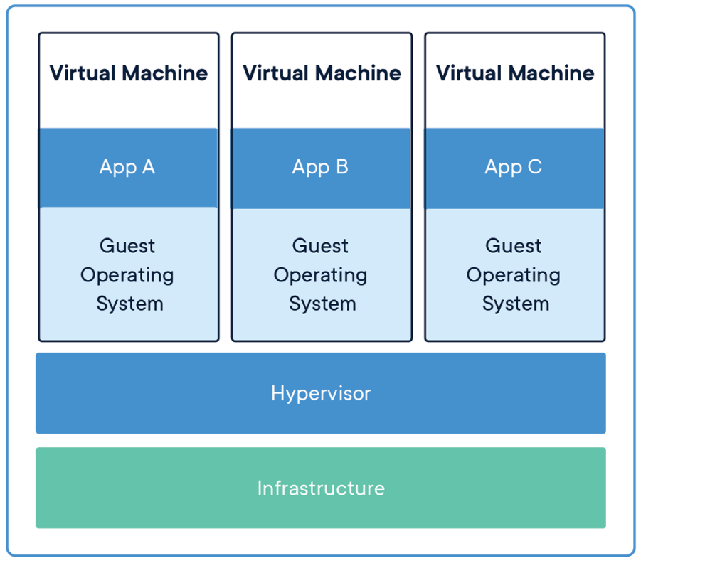
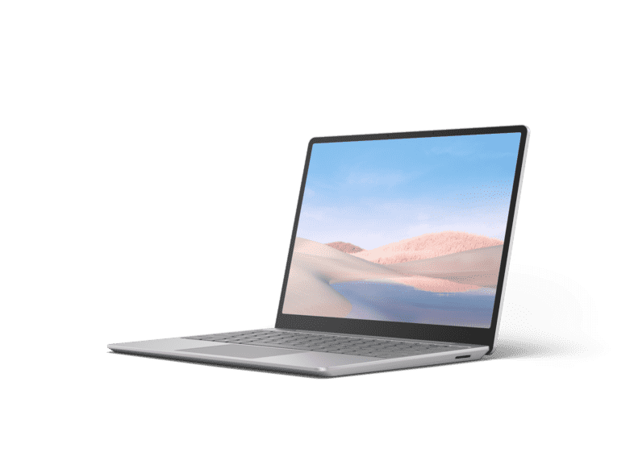
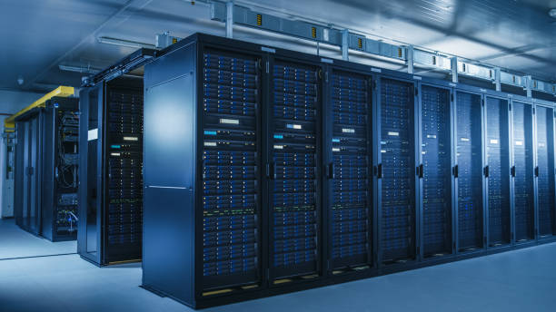
What is a VM?
Emulation of a computer
Contains:
Operating system
Networking
Memory & Storage
Etc.
Notes:
Typische productie/enterprise omgeving: VM’s. Wie weet wat een VM is?

Slide 15
Drawbacks of VM’s
Requires lots of configuration
Network
Storage & Memory etc.
Requires lots of resources
Each VM it’s own OS.
Requires maintenance
Updates etc.
SOLUTION: CONTAINERIZATION
Notes:
Typische productie/enterprise omgeving: VM’s. Wie weet wat een VM is?

Slide 16
Why do we (as developers) want containerization?
Notes:
Bredan/Gerard/Jeroen?

Slide 17
Why do we (as developers) want containerization?
Local development:
E.g. spin up a database of your choice without installing software
Ship your software to customers:
Faster / safer / reliable / predictable
Seperation of concerns:
Focus on coding instead of infrastructure
How? Use a tool like Docker!
Notes:
Typische productie/enterprise omgeving: VM’s. Wie weet wat een VM is?

Slide 18
What is Docker?
Notes:
Bredan/Gerard/Jeroen?

Slide 19

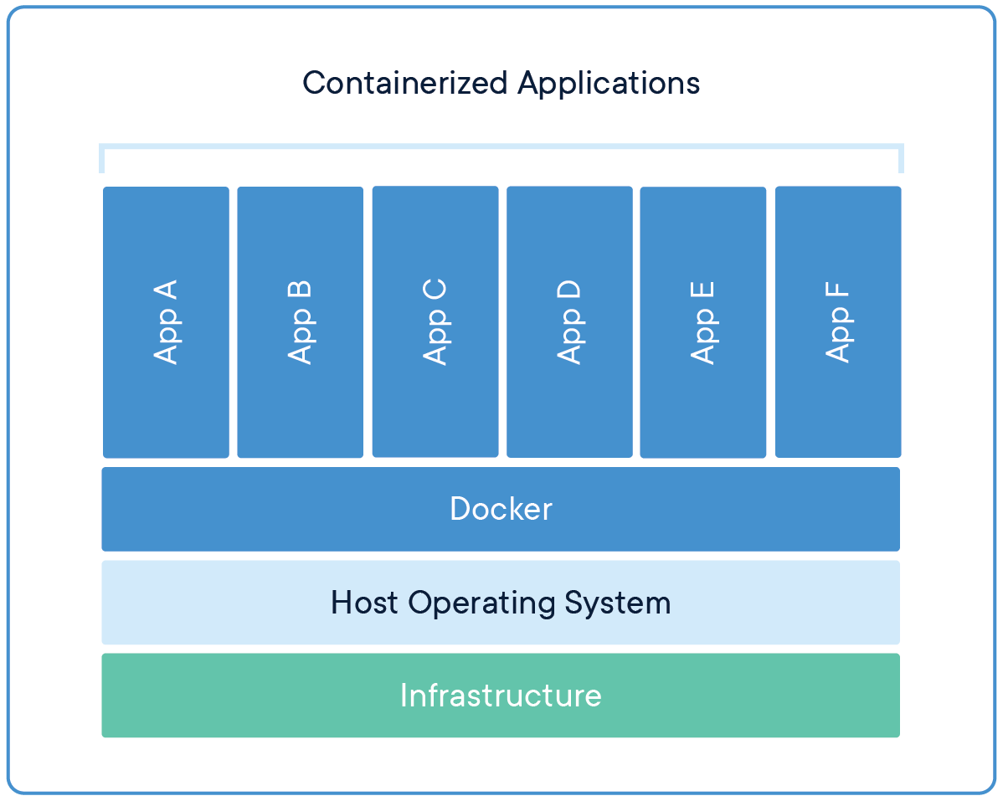
What is Docker?
A platform for building, running and shipping applications.
With Docker you can create executable packages, with ONLY the required runtime and other dependencies. The Docker engine uses the host OS to run the “containerized” applications, so only 1 OS is required.
Notes:
Platform om applicaties te runnen, bouwen en te shippen. Dit platform voorziet dus van alle benodigdheden om een applicatie te kunnen runnen. Efficiënt gebruik maken van resources!

Slide 20
What is a Container?
A standardized, running unit of software
Image: An executable package that contains everything needed to run the application (a blueprint, or recipe)
Container: A running instance of an image.
In OOP terms: An image is a class, and a container is the instantiation of that class.
Notes:
Platform om applicaties te runnen, bouwen en te shippen. Dit platform voorziet dus van alle benodigdheden om een applicatie te kunnen runnen.

Slide 21
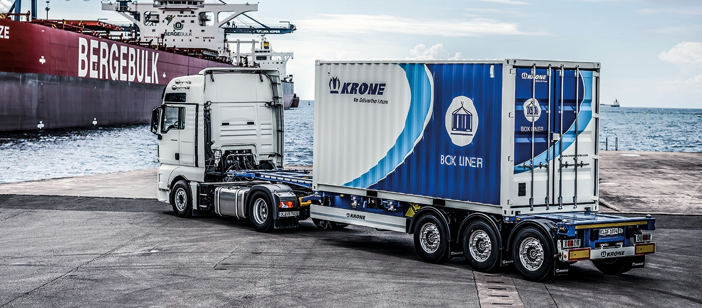
Containers
Container
Operating System
App
Interface
Prod
Bin/Libs/Config
Infrastructure
Docker Engine
Dev
Notes:
Uitleg met real world analogieën. Cabin is OS, motor en aandrijving infra, aanhanger is extensie via Docker Engine wat containers kan liften.

Slide 22
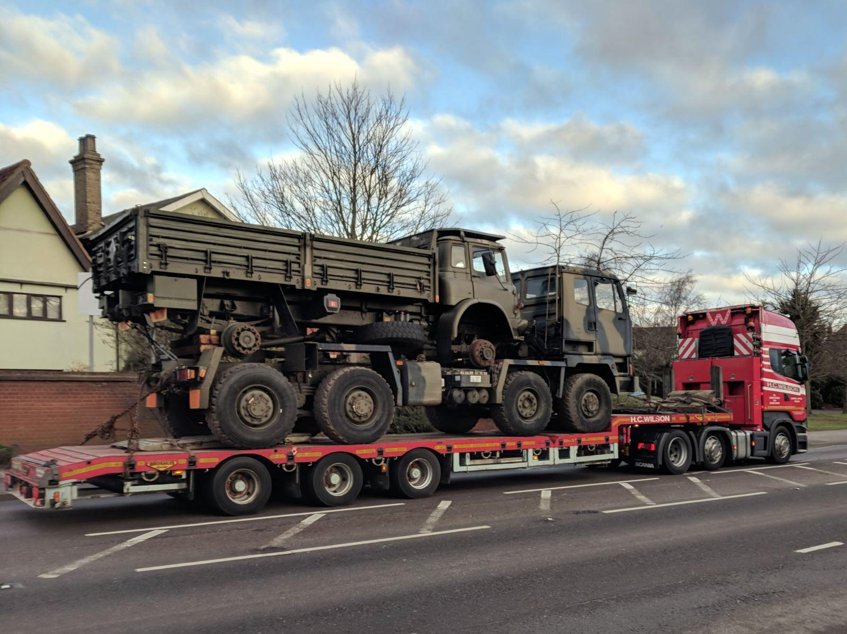
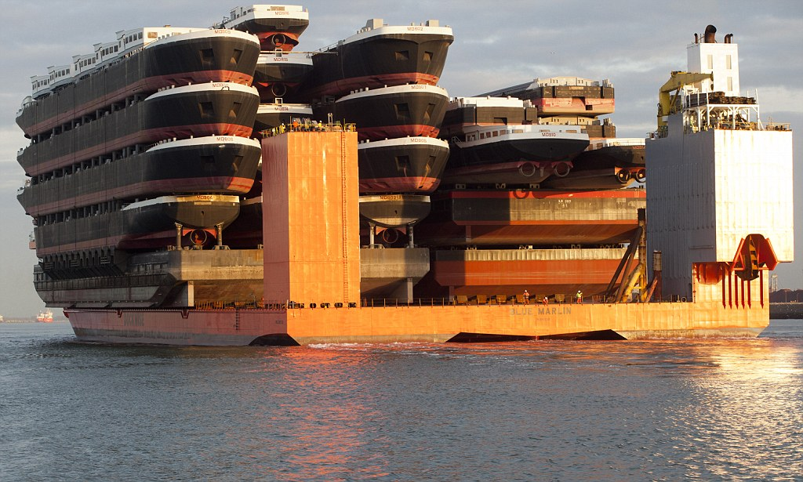
Virtualization
Notes:
VM is dus een truck op een truck, of een boot op een boot.

Slide 23


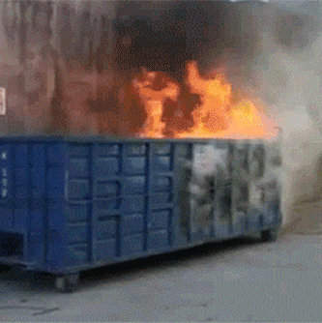

Before we begin
EWNET
❯ docker pull hello-world
Using default tag: latest
Error response from daemon: Get "https://registry-1.docker.io/v2/": net/http: request canceled while waiting for connection (Client.Timeout exceeded while awaiting headers)
IWNET
❯ docker pull hello-world
Using default tag: latest
latest: Pulling from library/hello-world
Digest: sha256:4f53e2564790c8e7856ec08e384732aa38dc43c52f02952483e3f003afbf23db
Status: Image is up to date for hello-world:latest
docker.io/library/hello-world:latest
Notes:
EWNET is bad for ya….

Slide 24
Demo Hello world image.
Check Docker Hub:
docker pull hello-world
docker image ls
docker run hello-world
Notes:
Bredan/Gerard/Jeroen? Voorbeeld hello-world is een C++ programma (binary) die “ergens” vandaan komt. Uitleg in volgende slide.

Slide 25
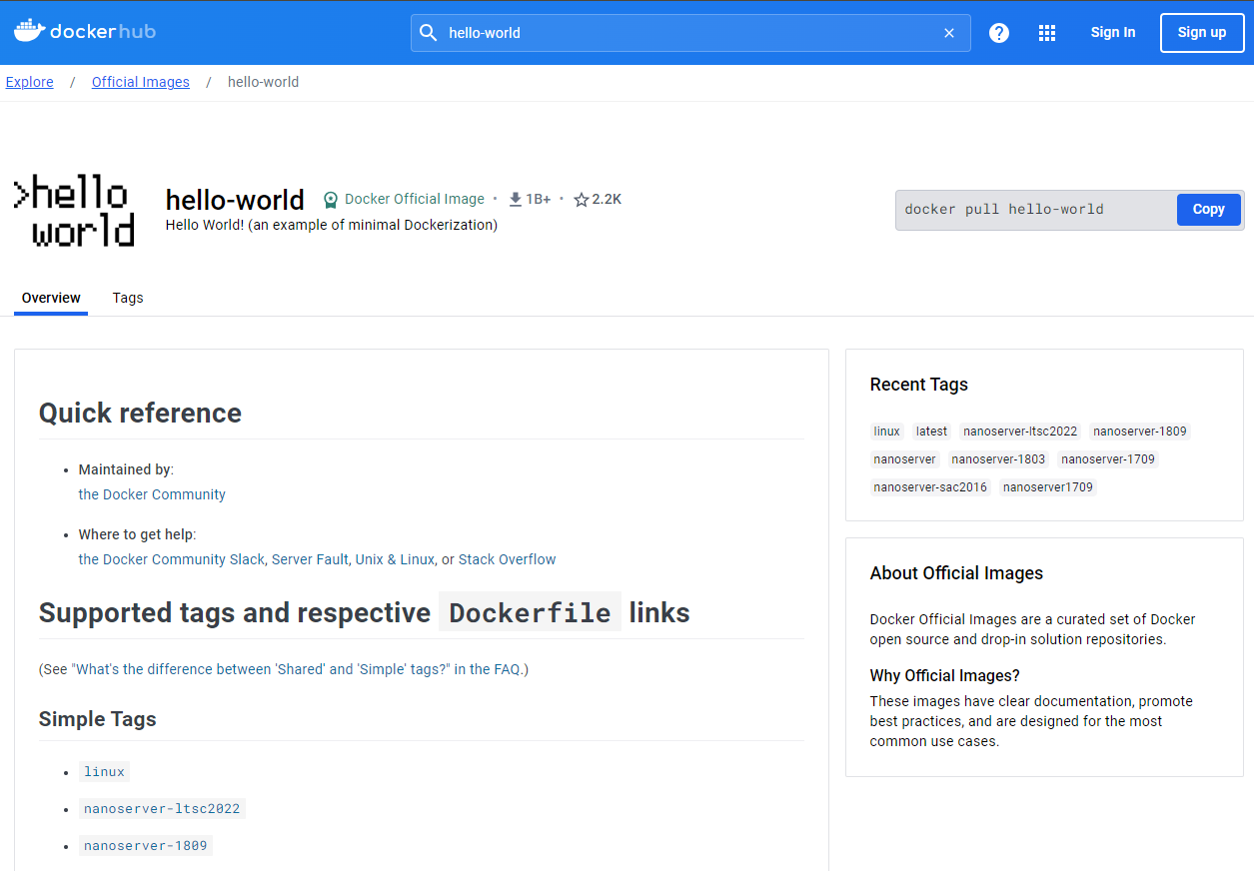
What did we just do?
Docker Hub
Internet
1: docker pull hello-world
hello-world:latest
Local machine
REPOSITORY TAG IMAGE ID CREATED SIZE
hello-world latest d2c94e258dcb 10 months ago 13.3kB
Container
Hello from Docker!
This message shows that your installation appears to be working correctly.
...
Local repository
hello-world:latest
2: docker image ls
3: docker run hello-world
Notes:
Stapsgewijs eerst goed uitleggen wat we nou hebben gedaan. Eerste keer docker commando’s draaien kan verwarrend zijn.

Slide 26
What did they do to create the image?
+ hello (binary/executable)
+ Dockerfile
Container
Repository
Image
Container
FROM [scratch|some-other-image]
COPY hello /
CMD ["/hello"]
Container
ADD / ARG / CMD / COPY / ENV / EXPOSE / LABEL / RUN / VOLUME …
docker build [OPTIONS] PATH | URL | -
docker run [OPTIONS] IMAGE [COMMAND] [ARG...]
Sources: https://hub.docker.com/_/hello-world, https://github.com/docker-library/hello-world
Notes:
Maar hoe maak je dan een image? Dit voorbeeld toont de Dockerfile van hello-world, dat worden layers. (Bijna) alk commando wordt een layer, een soort van spekkoek die je laagje voor laagje maakt.

Slide 27
Exercise: Create your own Hello world container.
Step 1: Create 1 simple java program.
Step 2: Find base image. (with correct requirements e.g. JDK)
Step 3: Create Dockerfile.
Step 4: build and run container.
Notes:
Party time!

Slide 28
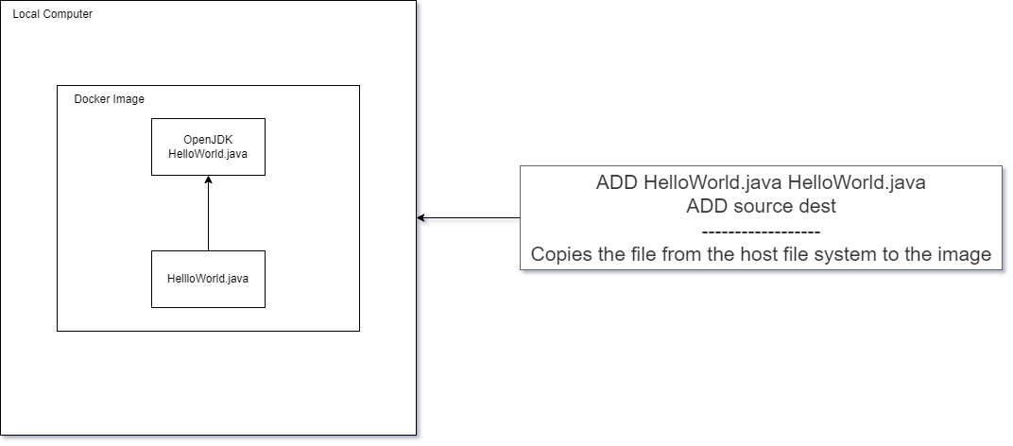
What did we just do?

Slide 29
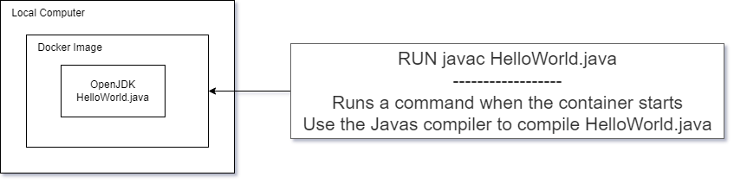
What did we just do?

Slide 30
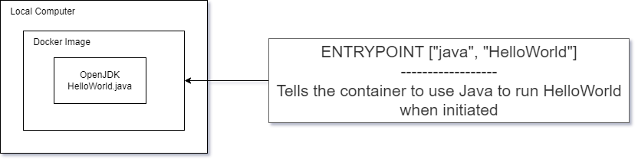
What did we just do?

Slide 31
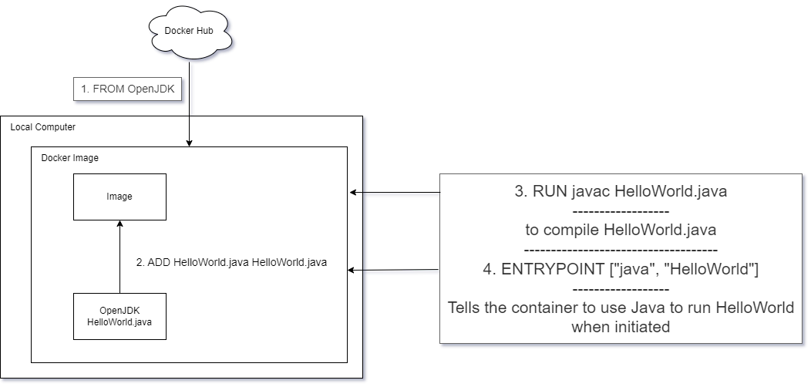
What did we just do?

Slide 32
What is scalability?
Notes:
Brendan

Slide 33
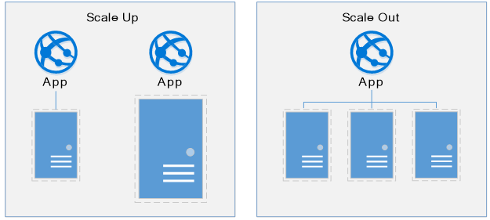
What is Scalability?
Vertical
Horizontal

Slide 34
Exercise 2: Scaling your hello world program.
Notes:
Deelnemers:

Slide 35
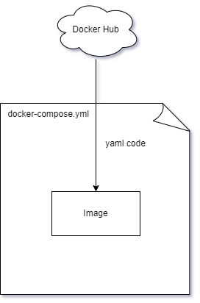
What the exercise achieved
Notes:
We used a docker compose file to have a scripted version of all the various docker commands we had to run manually before
Using a docker compose file we can have an easier time reproducing between systems without risking making copy paste mistakes.

Slide 36
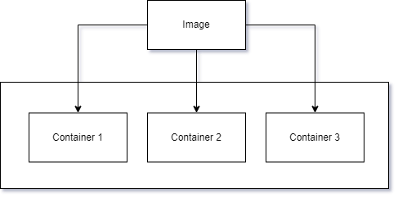
What the exercise achieved
Notes:
The docker image we build was spawned into 3 separate instances of the container

Slide 37
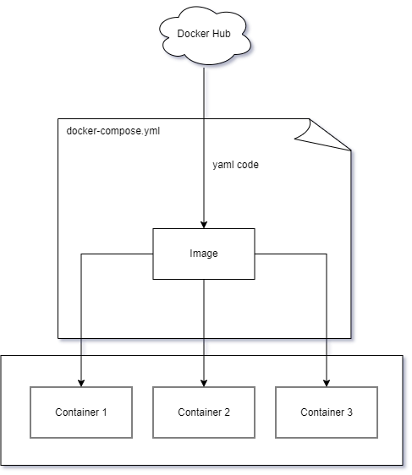
What the exercise achieved
Notes:
Putting it all together

Slide 38
What is a loadbalancer?
Notes:
Brendan

Slide 39
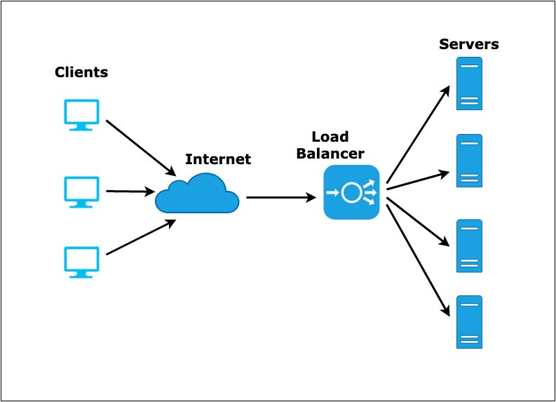
What is a loadbalancer?

Slide 40
Exercise 3: Loadbalancers.
Notes:
Deelnemers:

